Slide 1
Module-I
Introduction
to
Artificial Intelligence (AI)
and
Soft Computing (SC)

Slide 2
Agenda
Introduction to AI
Introduction to Agent and their types
Properties of environment
PEAS for Agent

Slide 3
Artificial Intelligence
Definition of AI:
"It is a branch of computer science by which we can create intelligent machines which can behave like a human, think like humans, and able to make decisions.“
Artificial Intelligence exists when a machine can have human based skills such as learning, reasoning, and solving problems

Slide 4
Why Artificial Intelligence?
With the help of AI, you can create such software or devices which can solve real-world problems very easily and with accuracy such as health issues, marketing, traffic issues, etc.
With the help of AI, you can create your personal virtual Assistant, such as Cortana, Google Assistant, Siri, etc.
With the help of AI, you can build such Robots which can work in an environment where survival of humans can be at risk.
AI opens a path for other new technologies, new devices, and new Opportunities.

Slide 5
Goals of Artificial Intelligence
Following are the main goals of Artificial Intelligence:
Replicate human intelligence
Solve Knowledge-intensive tasks
An intelligent connection of perception and action
Building a machine which can perform tasks that requires human intelligence such as:
Proving a theorem
Playing chess
Plan some surgical operation
Driving a car in traffic
Creating some system which can exhibit intelligent behavior, learn new things by itself, demonstrate, explain, and can advise to its user.

Slide 6
What Comprises to Intelligence?
Intelligence is an intangible part of our brain which is a combination of:
Reasoning
Learning
problem-solving
Perception
language understanding, etc.

Slide 7
Advantages & Disadvantages of AI
Advantages
Disadvantages
High Accuracy with less errors
High-Speed
High reliability
Useful for risky areas
Digital Assistant
Useful as a public utility
High Cost
Can't think out of the box
No feelings and emotions
Increase dependency on machines
No Original Creativity

Slide 8
Advantages..
High Accuracy with less errors: AI machines or systems are prone to less errors and high accuracy as it takes decisions as per pre-experience or information.
High-Speed: AI systems can be of very high-speed and fast-decision making, because of that AI systems can beat a chess champion in the Chess game.
High reliability: AI machines are highly reliable and can perform the same action multiple times with high accuracy.
Useful for risky areas: AI machines can be helpful in situations such as defusing a bomb, exploring the ocean floor, where to employ a human can be risky.
Digital Assistant: AI can be very useful to provide digital assistant to the users such as AI technology is currently used by various E-commerce websites to show the products as per customer requirement.
Useful as a public utility: AI can be very useful for public utilities such as a self-driving car which can make our journey safer and hassle-free, facial recognition for security purpose, Natural language processing to communicate with the human in human-language, etc.

Slide 9
Disadvantages…
High Cost: The hardware and software requirement of AI is very costly as it requires lots of maintenance to meet current world requirements.
Can't think out of the box: Even we are making smarter machines with AI, but still they cannot work out of the box, as the robot will only do that work for which they are trained, or programmed.
No feelings and emotions: AI machines can be an outstanding performer, but still it does not have the feeling so it cannot make any kind of emotional attachment with human, and may sometime be harmful for users if the proper care is not taken.
Increase dependency on machines: With the increment of technology, people are getting more dependent on devices and hence they are losing their mental capabilities.
No Original Creativity: As humans are so creative and can imagine some new ideas but still AI machines cannot beat this power of human intelligence and cannot be creative and imaginative

Slide 10
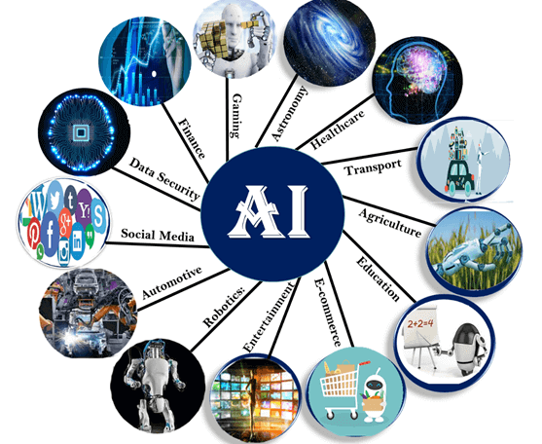
Application of AI
Artificial Intelligence has various applications in today's society. It is becoming essential for today's time. The Various sectors:
Astronomy
Healthcare
Gaming
Finance
Data Security
Social Media
Travel & Transport
Automotive Industry
Robotics
Entertainment
Agriculture
E-commerce
Education

Slide 11
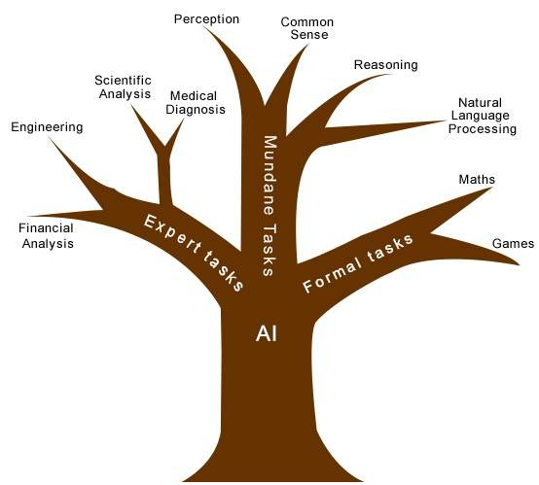
AI Problems (Tasks)
AI Problems can be classified as:
Mundane tasks
Formal tasks
Expert tasks

Slide 12
Agents
An agent can be anything that perceive its environment through sensors and act upon that environment through actuators. An Agent runs in the cycle of perceiving, thinking, and acting.
An agent can be:
Human-Agent:
Sensors : Eyes, Ears & Other Organs.
Actuators : Hand, Legs, Vocal tract.
Robotic Agent:
Sensors : Cameras, Infrared range finder, NLP
Actuators : Various motors
Software Agent:
Sensors : Keystrokes, File contents
Actuators : Screen
An intelligent agent is an autonomous entity which act upon an environment using sensors and actuators for achieving goals.

Slide 13
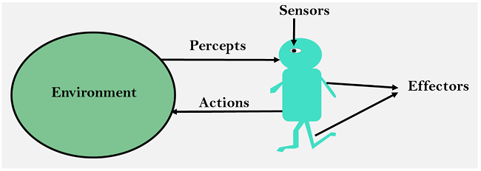
Agent
Sensor: It detects the change in the environment and sends the information to other electronic devices. An agent observes its environment through sensors.
Actuators: These are component of machines that converts energy into motion. The actuators are only responsible for moving and controlling a system.
Effectors: These are devices which affect the environment. Effectors can be legs, wheels, arms, fingers, wings, fins, and display screen.

Slide 14
Intelligent Agents:
Following are the main four rules for an AI agent:
Rule 1: An AI agent must have the ability to perceive the environment.
Rule 2: The observation must be used to make decisions.
Rule 3: Decision should result in an action.
Rule 4: The action taken by an AI agent must be a rational action.

Slide 15
Rational Agent
A rational agent is an agent which has clear preference, models uncertainty, and acts in a way to maximize its performance measure with all possible actions.
A rational agent is said to perform the right things. AI is about creating rational agents to use for game theory and decision theory for various real-world scenarios.
For an AI agent, the rational action is most important because in AI reinforcement learning algorithm, for each best possible action, agent gets the positive reward and for each wrong action, an agent gets a negative reward.

Slide 16
Rationality:
The rationality of an agent is measured by its performance measure. Rationality can be judged on the basis of following points:
Performance measure which defines the success criterion.
Agent prior knowledge of its environment.
Best possible actions that an agent can perform.
The sequence of percepts.

Slide 17
Structure of an AI Agent
The task of AI is to design an agent program which implements the agent function.
The structure of an intelligent agent is a combination of architecture and agent program. It can be viewed as:
Agent = Architecture + Agent program
Following are the main three terms involved in the structure of an AI agent:
Architecture: Architecture is machinery that an AI agent executes on.
Agent Function: Agent function is used to map a percept to an action.
f : P* → A
Agent program: Agent program is an implementation of agent function. An agent program executes on the physical architecture to produce function f.

Slide 18
Types of AI Agents
Agents can be grouped into five classes based on their degree of perceived intelligence and capability. These are given below:
Simple Reflex Agent
Model-based reflex agent
Goal-based agents
Utility-based agent
Learning agent

Slide 19
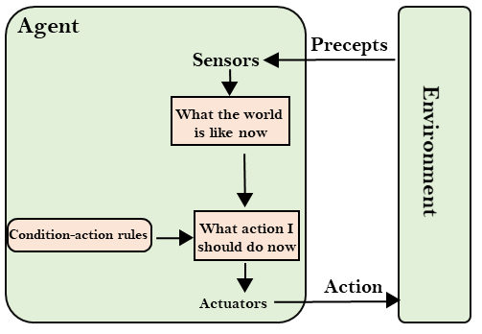
1. Simple Reflex Agent:
Succeed in the fully observable environment.
Take decisions on the basis of the current percepts and ignore the rest of the percept history.
Do not consider any part of percepts history during their decision and action process.
Works on Condition-action rule, which means it maps the current state to action. Eg. Room Cleaner agent

Slide 20
1. Simple Reflex Agent:
Problems for the simple reflex agent design approach:
Limited intelligence
Don’t have knowledge of non-perceptual parts of the current state
Mostly too big to generate and to store.
Not adaptive to changes in the environment.

Slide 21
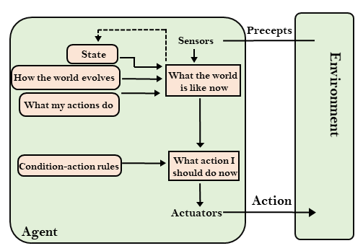
2. Model-based reflex agent
It can work in a partially observable environment and track the situation.
A model-based agent has two important factors:
Model: It is knowledge about "how things happen in the world," so it is called a Model-based agent.
Internal State: It is a representation of the current state based on percept history.

Slide 22
2. Model-based reflex agent
These agents have the model, "which is knowledge of the world" and based on the model they perform actions.
Updating the agent state requires information about:
How the world evolves?
How the agent's action affects the world?

Slide 23
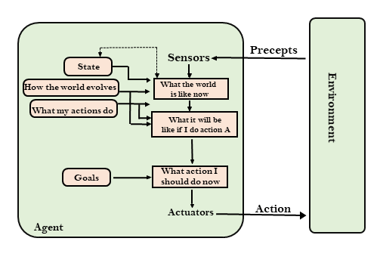
3. Goal-based agents
The knowledge of the current state environment is not always sufficient to decide for an agent to what to do?
The agent needs to know its goal which describes desirable situations.
It expand the capabilities of the model-based agent by having the "goal" information.
They choose an action, so that they can achieve the goal.
These agents may have to consider a long sequence of possible actions before deciding whether the goal is achieved or not.

Slide 24
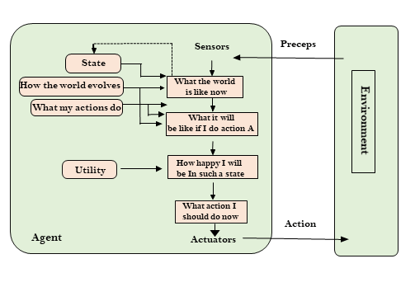
4. Utility-based agents
These agents provide an extra component of utility measurement which makes them different by providing a measure of success at a given state.
Its act based not only goals but also the best way to achieve the goal.
It is useful when there are multiple possible alternatives, and an agent must choose in order to perform the best action.
The utility function maps each state to a real number to check how efficiently each action achieves the goals.

Slide 25
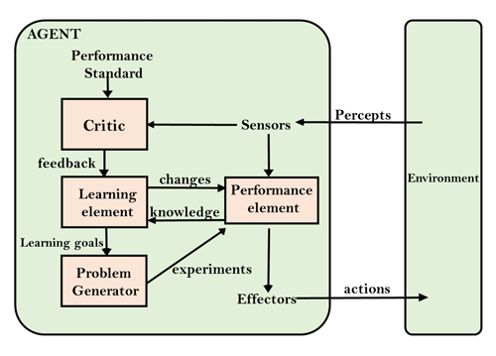
5. Learning Agents
A learning agent in AI is the type of agent which can learn from its past experiences, or it has learning capabilities.
It starts to act with basic knowledge and then able to act and adapt automatically through learning.

Slide 26
5. Learning Agents
A learning agent has mainly four conceptual components, which are:
Learning element: It is responsible for making improvements by learning from environment.
Critic: Learning element takes feedback from critic which describes that how well the agent is doing with respect to a fixed performance standard.
Performance element: It is responsible for selecting external action
Problem generator: This component is responsible for suggesting actions that will lead to new and informative experiences.
Hence, learning agents can learn, analyze performance, and look for new ways to improve the performance.

Slide 27
PEAS Representation
PEAS is a type of model on which an AI agent works upon. It is made up of four words:
P: Performance measure
E: Environment
A: Actuators
S: Sensors
Note: Here performance measure is the objective for the success of an agent's behavior.

Slide 28
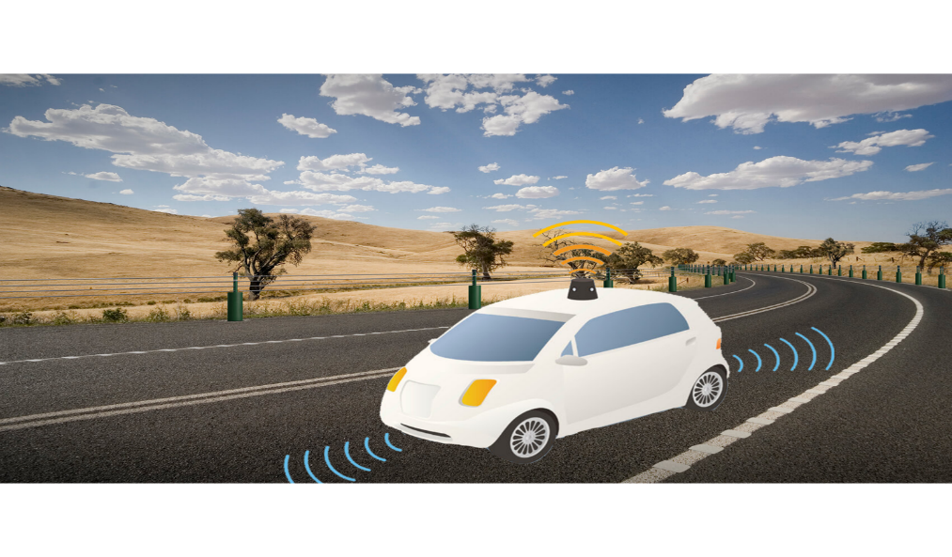
PEAS for self-driving cars:
Let's suppose a self-driving car then PEAS representation will be:
Performance: Safety, time, legal drive, comfort
Environment: Roads, other vehicles, road signs, pedestrian
Actuators: Steering, accelerator, brake, signal, horn
Sensors: Camera, GPS, speedometer, odometer, accelerometer, sonar.

Slide 29
Example of Agents with their PEAS representation
Agent | Performance measure | Environment | Actuators | Sensors
Medical Diagnose | Healthy patient Minimized cost | Patient Hospital Staff | Tests Treatments | Keyboard (Entry of symptoms)
Vacuum Cleaner | Cleanness Efficiency Battery life Security | Room Table Wood floor Carpet Various obstacles | Wheels Brushes Vacuum Extractor | Camera Dirt detection sensor Cliff sensor Bump Sensor Infrared Wall Sensor
Part -picking Robot | Percentage of parts in correct bins. | Conveyor belt with parts, Bins | Jointed Arms Hand | Camera Joint angle sensors.

Slide 30
Agent Environment in AI
An environment can be described as a situation in which an agent is present.
An environment is everything in the world which surrounds the agent, but it is not a part of an agent itself.
The environment is where agent lives, operate and provide the agent with something to sense and act upon it.

Slide 31
Features of Environment
An environment can have various features from the point of view of an agent:-
1. Fully observable vs Partially Observable
2. Static vs Dynamic
3. Discrete vs Continuous
4. Deterministic vs Stochastic
5. Single-agent vs Multi-agent
6. Episodic vs sequential
7. Known vs Unknown
8. Accessible vs Inaccessible

Slide 32
Features of Environment
1. Fully observable vs Partially Observable:
If an agent sensor can sense or access the complete state of an environment at each point of time then it is a fully observable environment, else it is partially observable.
A fully observable environment is easy as there is no need to maintain the internal state to keep track history of the world.
An agent with no sensors in all environments then such an environment is called as unobservable.
2. Deterministic vs Stochastic:
If an agent's current state and selected action can completely determine the next state of the environment, then such environment is called a deterministic environment.
A stochastic environment is random in nature and cannot be determined completely by an agent.
In a deterministic, fully observable environment, agent does not need to worry about uncertainty.

Slide 33
-
Features of Environment
3. Episodic vs Sequential:
In an episodic environment, there is a series of one-shot actions, and only the current percept is required for the action.
However, in Sequential environment, an agent requires memory of past actions to determine the next best actions.
4. Single-agent vs Multi-agent
If only one agent is involved in an environment and operating by itself, then such an environment is called single agent environment.
However, if multiple agents are operating in an environment, then such an environment is called a multi-agent environment.
The agent design problems in the multi-agent environment are different from single agent environment.

Slide 34
Features of Environment
5. Static vs Dynamic:
If the environment can change itself while an agent is deliberating, then such environment is called a dynamic environment else it is called a static environment.
Static environments are easy to deal because an agent does not need to continue looking at the world while deciding for an action.
However, for dynamic environment, agents need to keep looking at the world at each action.
Taxi driving is an example of a dynamic environment whereas Crossword puzzles are an example of a static environment.
6. Discrete vs Continuous:
If in an environment there are a finite number of percepts and actions that can be performed within it, then such an environment is called a discrete environment else it is called continuous environment.
A chess game comes under discrete environment as there is a finite number of moves that can be performed.
A self-driving car is an example of a continuous environment.

Slide 35
-
Features of Environment
7. Known vs Unknown
Known and unknown are not actually a feature of an environment, but it is an agent's state of knowledge to perform an action.
In a known environment, the results for all actions are known to the agent. While in unknown environment, agent needs to learn how it works in order to perform an action.
It is quite possible that a known environment to be partially observable and an Unknown environment to be fully observable.
8. Accessible vs Inaccessible
If an agent can obtain complete and accurate information about the state's environment, then such an environment is called an Accessible environment else it is called inaccessible.
An empty room whose state can be defined by its temperature is an example of an accessible environment.
Information about an event on earth is an example of Inaccessible environment.

Slide 36
QUIZ
1. The term Artificial Intelligence was coined by_____________________ a) Bill Gates b) Larry Page c) Steve Jobs d) John McCarthy
2. The domain of AI is classified into ____ , ____ and ____ tasks a) Formal, Mundane, and Expert b) Input , Processing and Output c) Intercept, Interpret and Infer d) None of the mentioned
3. Common Sense , Reasoning , Perception and NLP belongs to ___
a) Formal Tasks b) Mundane Tasks c) Expert Tasks d) None of the mentioned

Slide 37
QUIZ
Which instruments are used for perceiving and acting upon the environment? a) Sensors and Actuators b) Sensors c) Perceiver d) None of the mentioned
What is the expansion of PEAS in task environment? a) Peer, Environment, Actuators, Sense
b) Perceiving, Environment, Actuators, Sensors c) Performance, Environment, Actuators, Sensors
d) None of the mentioned
Sophia Robot is developed at ________
a) Boston Dynamics b) Apple c) Hanson Robotics d) Sony Electronics

Slide 38
QUIZ
The rational agent is one which ______
a) Knows Everything b) Does the right things c) acts like human d) Thinks like human
What is the rule of simple reflex agent? a) Simple-action rule b) Condition-action rule c) Both a & b d) None of the mentioned
In which agent does the problem generator is present? a) Learning agent b) Observing agent c) Reflex agent d) None of the mentioned
Which agent deals with happy and unhappy states? a) Simple reflex agent b) Model based agent c) Learning agent d) Utility based agent

Slide 39

QUIZ
4. What kind of environment is crossword puzzle? a) Partially Observable b) Fully Observable c) Deterministic d) both b and c
5. What provides the feedback to the learning element? a) Critic b) Actuators c) Sensor d) None of the mentioned

Slide 40
Introduction
to
Soft Computing

Slide 41
What is Soft Computing?
The idea behind soft computing is to model cognitive behavior of human mind.
Soft computing is foundation of conceptual intelligence in machines.
Soft computing is defined as a collection of techniques spanning many fields that fall under various categories in computational intelligence.
Soft computing has main branches:
Fuzzy Systems
Evolutionary computation
Artificial neural computing
Machine Learning (ML)
Probabilistic Reasoning (PR)
Belief networks
Parts of learning theory
Wisdom based Expert System (WES), etc.

Slide 42
Soft and Hard Computing
Hard Computing | Soft computing
Conventional computing requires a precisely stated analytical model. | Soft computing is tolerant of imprecision.
Often requires a lot of computation time. | Can solve some real-world problems in reasonably less time.
Not suited for real world problems for which ideal model is not present. | Suitable for real world problems.
It requires full truth | Can work with partial truth
It is precise and accurate. | Imprecise
High cost for solution. | Low cost for solution.

Slide 43
Soft Computing
Soft Computing is an approach for constructing systems which are computationally intelligent, possess human like expertise in particular domain, can adapt to the changing environment, can learn to do better and can explain their decisions
Components of Soft Computing include:
Fuzzy Logic (FL)
Evolutionary Computation (EC)
Genetic Algorithm
Swarm Intelligence
Neural Network (NN)
Machine Learning (ML)

Slide 44
Techniques In Soft Computing:
1. Neural Networks (NN)
An Artificial Neural Network (ANN) is an information processing paradigm that is inspired by the way biological nervous systems, such as the brain, process information.
The key element of this paradigm is the novel structure of the information processing system.
It is composed of a large number of highly interconnected processing elements (neurons) working in unison to solve specific problems.
ANNs, like people, learn by example.
An ANN is configured for a specific application, such as pattern recognition or data classification, through a learning process.
Learning in biological systems involves adjustments to the synaptic connections that exist between the neurons.
This is true for ANNs as well.

Slide 45
Techniques In Soft Computing:
2. Fuzzy Logic (FL)
FL is a problem-solving control system methodology that lends itself to implementation in systems ranging from simple, small, embedded micro-controllers to large, networked, multi-channel PC or workstation- based data acquisition and control systems.
It can be implemented in hardware, software, or a combination of both.
FL provides a simple way to arrive at a definite conclusion based upon vague, ambiguous, imprecise, noisy, or missing input information.
FL’s approach to control problems mimics how a person would make decisions, only much faster.

Slide 46
Techniques In Soft Computing:
3. Genetic Algorithms in Evolutionary Computation
A genetic or evolutionary algorithm applies the principles of evolution found in nature to the problem of finding an optimal solution to a Solver problem.
In a "genetic algorithm.” the problem is encoded in a series of bit strings that are manipulated by the algorithm.
In an “evolutionary algorithm,” the decision variables and problem functions are used directly.
Most commercial Solver products are based on evolutionary algorithms.

Slide 47
Applications of Soft Computing
Handwriting Recognition
Image Processing and Data Compression
Automotive Systems and Manufacturing
Soft Computing to Architecture
Decision-support Systems
Soft Computing to Power Systems
Neuro Fuzzy systems
Fuzzy Logic Control
Machine Learning Applications
Speech and Vision Recognition Systems
Process Control and So On

